Slide 1
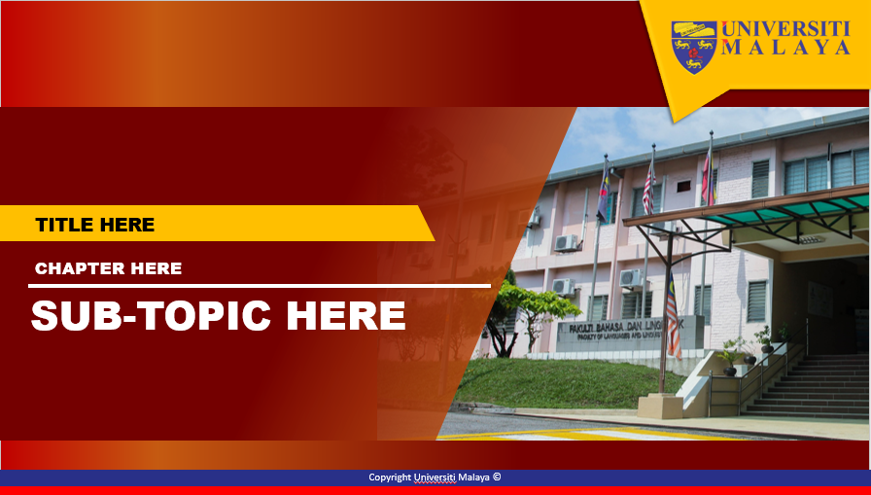
FAKULTI BAHASA DAN LINGUISTIK
GBT 0002 : CRITICAL THINKING AND PROBLEM SOLVING SKILLS

Slide 2
WEEK 2
CLARIFICATION AND INTERPRETATION OF IDEAS

Slide 3

Clarification and
Interpretation of Ideas

Slide 4
Background
A. Critical Thinking
Wide range of cognitive skills
(identify, analyze, and evaluate arguments /claims)
To discover and overcome personal preconceptions and biases
To formulate and present convincing reasons
To make reasonable decisions

Slide 5
B. Benefits of Critical Thinking
Improve ability to understand, construct, and criticize arguments
Solve problems, think creatively, communicate ones ideas clearly & effectively
Reduce mistake in decision making
Free from unexamined assumptions, prejudices

Slide 6
C. Major Barriers to Critical Thinking
Egocentrism
Sociocentrism
Unwarranted assumptions
Relativistic thinking
Wishful thinking

Slide 7
Egocentrism
Tendency to see reality as centered on oneself:
a. self-interest thinking
- should weigh evidence & arguments
objectively & impartially
b. Superiority bias
“ How quick come the reasons for
approving what we like”
Jane Austen
“Admit your faults. I would if I had any”
Milton Berle

Slide 8
2. Sociocentrism
- Group-centered thinking
a. group bias
b. conformism
“ Custom and example have a much more persuasive power than certitude obtained by way of inquiry”
Renẽ Descartes

Slide 9
3. Unwarranted Assumptions
Something we take for granted without good
reason
a. Stereotypes
- hasty generalization
“ General notions are generally wrong”
Mary Worthley Montague

Slide 10
4. Relativistic thinking
the view that truth is a matter of opinion
a. Cultural relativism
eg. Eating beef for an Indian (religion background)
b. Moral subjectivism
eg. Premarital sex

Slide 11
5. Wishful Thinking
- believing something not because you had good evidence for it but simply because you wished it were true
eg. Able to communicate with the dead
“ A man hears what he wants to hear and
disregards the rest”
Paul Simon

Slide 12
D. Clarification
1. Explanation of information is needed in the process of making decision
Reader / audience
Aim / objective of explanation
Variety of methods in explaining the meaning

Slide 13
2. What are the problems?
Unclear
ambiguous
Need example

Slide 14
3.How to curb problem
Ask writer/ author for meaning
Ask for related example
Identify the benchmark that are being used
4. Who are the readers/ audiences
Type/ Category
Backround knowledge
beliefs

Slide 15
5. Method of explanations
Source | Solutions
Dictionary Definition Explanation from expert Common meaning | Synonym Giving rules Examples Antonym background information

Slide 16
5(a). Sources
Dictionary
- common usage
- general readers
B. Definition
- usage based on expertise/area
- reliable source
C. Common meaning
- current usage of words

Slide 17
5(b). Solutions
Synonym
- expression with same meaning
- common used words by
readers/audiences
B. Abide by rules
- giving examples
- poetic vs royal language vs colloqual
(eg.’teruna’ vs ‘putera’ vs ‘remaja’ vs
‘belia’ vs ‘lelaki muda’
C. Background information/ history

Slide 18
Questioning is the door to knowledge
He that nothing questions nothing learned
It is not disgraceful to ask. It is disgraceful not to ask
He who asks a question is a fool for five minutes.
He who does not ask a question remains a fool forever
If you are ashamed to ask questions, you will only lose your way

Slide 19
Discussion
What is the gist of the message?
Is there any support information?
What/ Who initiated the idea?
What are the similarities or differences between the two articles/ stories?
What are the meaning to the keywords?
Is there any statement being made?
Is it fact or opinion?
Is it factual or inference?
Is the statement based on truth or controversial?
What is the different between fake and misquote?

Slide 20
Terima kasih
Thank you
Arigatou Gozaimasu

